Slide 1

Decoding Hotel Booking Patterns: An EDA Approach
PRESENTED BY:
JANMEJAY AMIN
April 18, 2024
GUIDED BY:
ABHISHEK WAHVAL

Slide 2


Content
003 | Project Impacts
004 | Variable Attributes
006 | Data Cleaning Process
007 | Visualization and Analysis of Data, with Business Strategies
022 | Conclusion

Slide 3
IMPROVED OPTIONS | It will assist hotels in making more informed decisions on how to treat their clients.
MINIMAL CANCELLATIONS | It will analyze why guests cancel and help to reduce those numbers.
INCREASED PROFITABILITY | Knowing more about the booking patterns of clients can help hotels set rates of room accordingly
BE FUTURE READY | Insights from this EDA will help Hotels in being up to date with the trends in future
Project
Impacts
Here are some positive impacts that this study will provide for the Hotels

Slide 4
Variable Attributes
##Previous Cancellations: Number of past cancellations ##Previous Completed Bookings: Number of past non-cancelled bookings | ##Reserved Room Type: Code for reserved room ##Assigned Room Type: Code for assigned room ##Booking Changes: Number of modifications to booking
##Type of Hotel: Resort or City ##Cancellation Status: Booked (0) or Cancelled (1) ##Lead Time: Days from booking to arrival ##Arrival Details: Year, Month, Week Number ##Stay Duration: Weekend Nights, Week Nights | ##Guest Composition: Adults, Children, Babies ##Country of Origin: Guest's home country ##Customer Type: Four categories (to be specified) ##Repeated Guest: Yes (1) or No (0) ##Meal Preference: Type of meal booked
U for unveil | Any number from 0-9 for a timer

Slide 5
Variable Attributes
##Average Daily Rate (ADR): Average Daily Rate ##Deposit Type: Nature of deposit made ##Required Extras: Car parking spaces & special requests | ##Market Segment: Category based on booking patterns ##Distribution Channel: Booking distribution method ##Agent: Identifier for booking agent or company
##Days in Waiting List: Time on waiting list ##Reservation Status: Current booking status | ##Days in Waiting List: Time on waiting list ##Reservation Status: Current booking status

Slide 6
HOTEL BOOKING
DATA-SET
Total Data
119389
Data Cleaning
Process
Removed Company column as it had 82137 missing values
Unique Data
87396
Removed
31,966 Duplicate Rows
Agent had 12193 missing values
Country had 452 missing values
Children had 4 missing values
Replaced 12193 values of agent with Others
Removed 452 country missing values
Removed 4 Children missing values
Merged [Day],[Month],[Year] in a single column

Slide 7
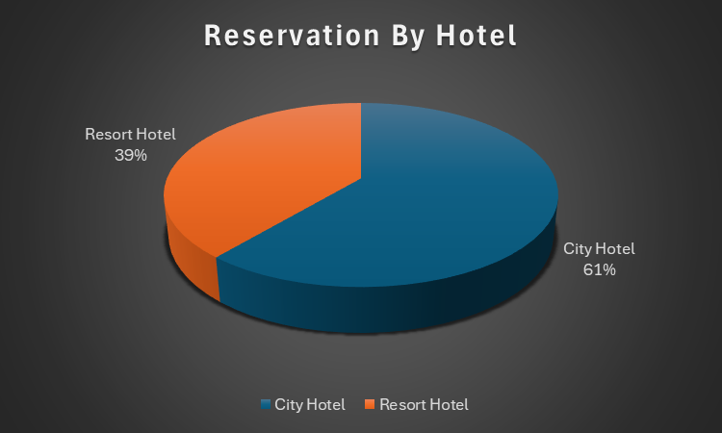
Number of Bookings by Hotels
Here Pie Chart is used to represent
the data in a easy to understand way.
It is found that 61% prefer City Hotel, while 39% prefer the Resort
Hotel.
Here the city hotel is attracting more clients than resort hotel , the resort hotel can try can provide services similar to city hotel so that more bookings can be generated.

Slide 8
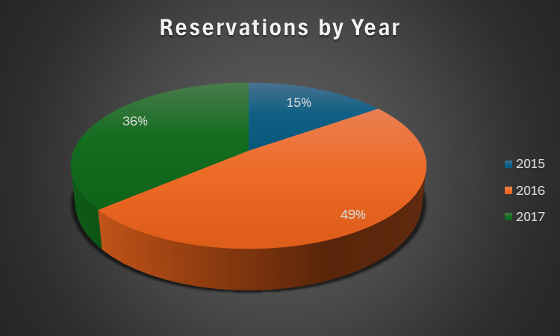
Number of Bookings by Year
Here Pie Chart is used to represent
the data in a easy to understand way.
It is found that 2015 had 15% of total reservation while 2016 had 49% and 2017 had 36%.
It can be said that 2016 was the most successful year so far and strategic actions taken during the year should be reviewed again to increase the number of reservations.

Slide 9
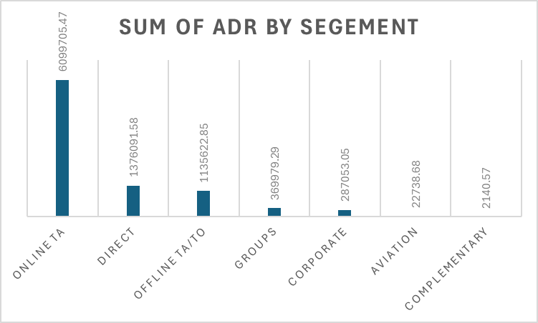
ADR by Segment
Here Column chart is used to represent the data in a easy to understand way.
It is found that online TA has the highest ADR of 60.99L and the lowest is complimentary i.e 2140.
It can be said that people choose to book the property via a Online TA rather than any other segment, maybe the hotels should focus more on the direct bookings so that it doesn't have to pay much in commissions to online agents

Slide 10
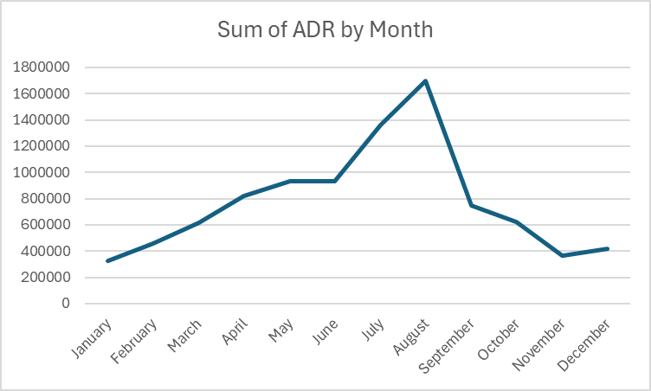
ADR by Month
Here Line Chart is used to represent the data in a easy to understand way.
It is found that August has the highest ADR of 16.98L and the lowest is of January i.e 3.28L.
It can be said that most busy time of the year is from May till September. Peaking between July and August, As ADR is total revenue earned divided by total rooms.

Slide 11
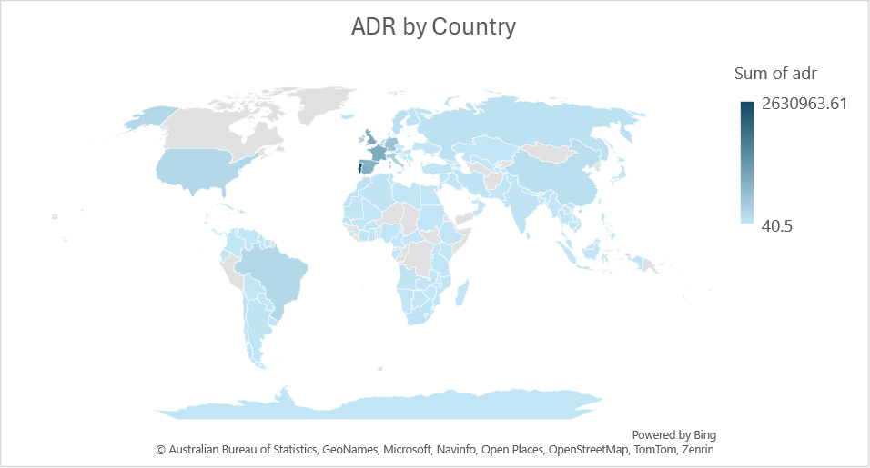
ADR by Country
Here Map Chart is used to represent the data in a easy to understand way.
It is found that Portugal has the highest ADR of 26.30L and the lowest is of Cayman Islands i.e 40.5.
It can be said that hotel needs to create some offers specific to the country where less reservations are made to increase the reservations.

Slide 12
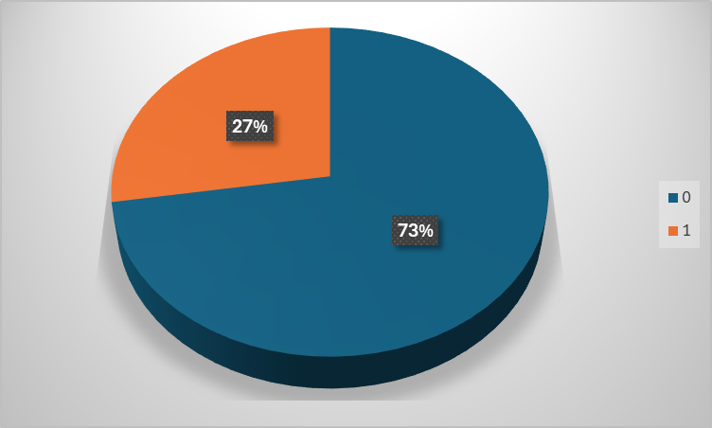
Stayed V/s Cancelled ?
Here Pie Chart is used to represent the data in a easy to understand way.
It is found that 27% of the total bookings of both hotels were cancelled.
Hotel should have a feedback form sent over to the clients who have cancelled the booking so that the reason of this many cancellation can be know

Slide 13
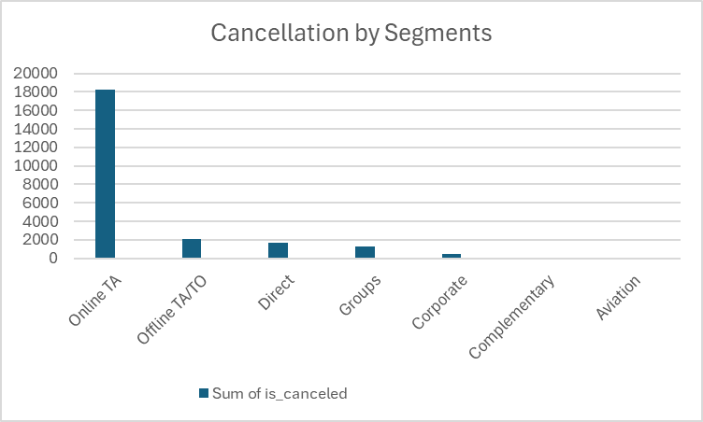
Cancellation by Segment
Here Column Chart is used to represent the data in a easy to understand way.
It is found that 18.24k of the total cancellation of both hotels was from online TA.
It means even though Online TA is getting a lot of bookings but it also gets many cancellations as well. Hotel should check the reasons of their cancellation. As hotels could generate good amount from online TA.

Slide 14
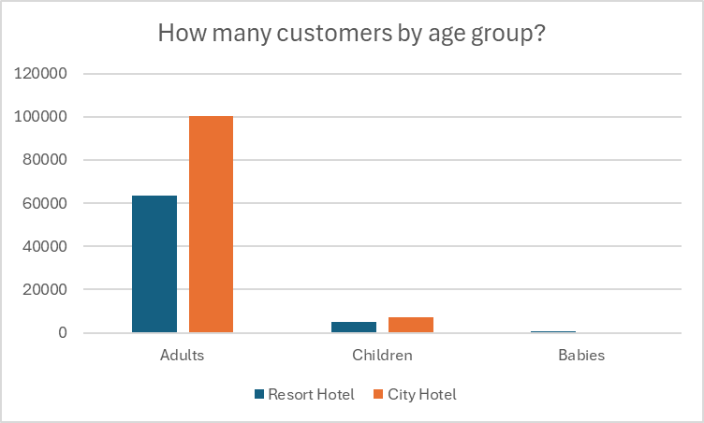
Customers by Age-Group
Here Clustered Column Chart is used to represent the data in a easy to understand way.
It is found that city hotel has more number of customers by adults but in case of Children and babies there is almost no major difference.

Slide 15
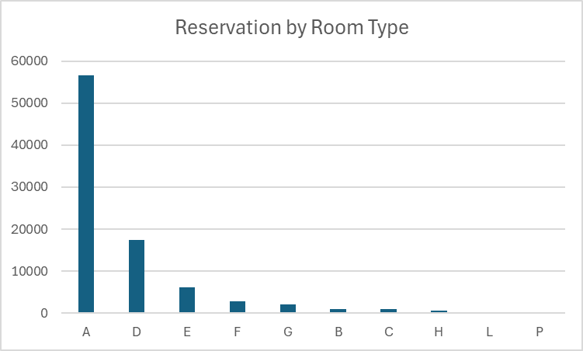
Reservations by Room Type
Here Clustered Column Chart is used to represent the data in a easy to understand way.
It is found that room type A is the most booked at 56552 times in both the hotels followed by room type D at 17398.
It can be said that Hotels need to focus on add more rooms of A & D type so that they can accommodate more guests as they are the most preferred room types by clients.

Slide 16
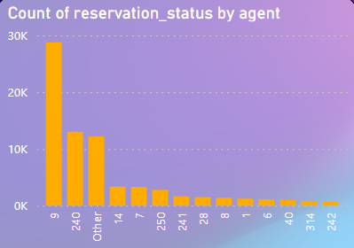
Agents by Bookings
Here Clustered Column Chart is used to represent the data in a easy to understand way.
It is found that agent 9 has the most bookings at 28758 followed by agent 240 at 13028.
It can be said that Hotels need to focus on building good relationships with the agents with higher bookings so that hotels can further leverage that relationships to get more bookings.

Slide 17
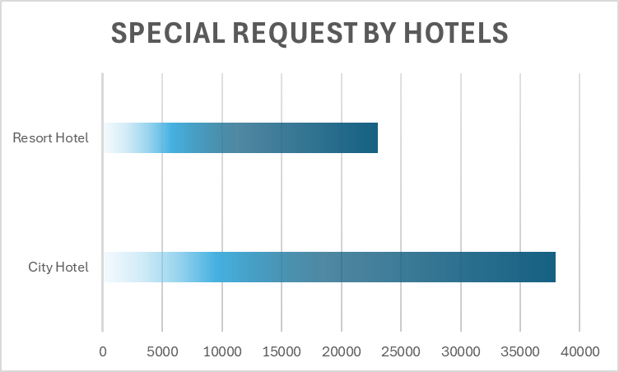
Special Requests by Hotel
Here Bar Chart is used to represent the data in a easy to understand way.
It is found that City Hotel had the most Special Requests at 37982 and Resort Hotel had 23065 Special Requests.
It can be said that City Hotel is getting more Special Requests than Resort Hotels

Slide 18
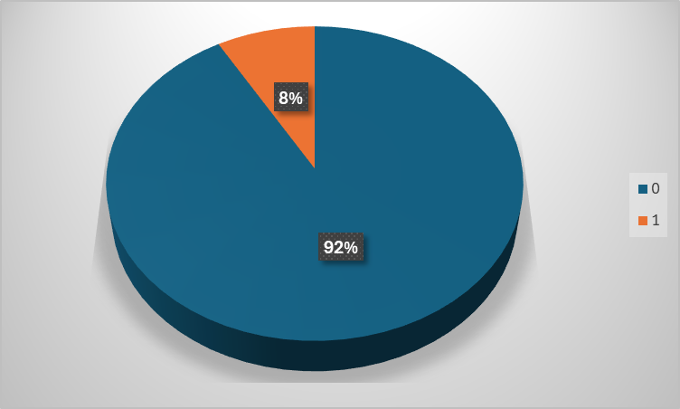
Parking Space Required
Here Pie Chart is used to represent the data in a easy to understand way.
It is found that 8% i.e 7313 requested parking space while the other 92% i.e 80079 did not need the parking space.
It means out of total 87392 only 8% required parking space so that the hotel can plan accordingly to accommodate parking in their premises.

Slide 19
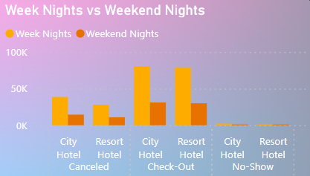
Week Nights V/s Weekend Nights
Here Clustered Column Chart is used to represent the data in a easy to understand way.
It is found that Weekday Nights are more busy i.e 80632 than Weekend Nights i.e 31197 in City Hotel.
Same can be said for the Resort Hotel it is more busy at Week Nights i.e 79097 than Weekend Nights i.e 30084
It means Hotels should plan out more for the Weekday Stays as they have higher booking during that duration.

Slide 20
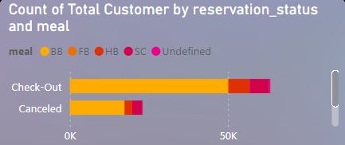

Reservation by Meals
Here Clustered Bar Chart is used to represent the data in a easy to understand way.
It is found that the most frequent meal taken with bookings is BB i.e Bed and Breakfast followed FB i.e Full Board.
Hotels should focus more on BB as it is the most taken meal during the stay. Hotel should pre plan the menu keeping this in mind.

Slide 21
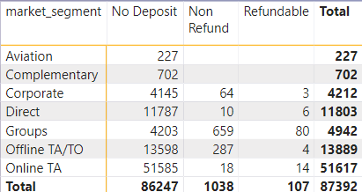
Deposits by Market Segment
Here Matrix Table is used to represent the data in a easy to understand way.
It is found that out of 87392 bookings 86247 booking were done without deposit 1038 bookings were done with deposit but its non refundable, and 107 bookings were with refundable deposit.
The Hotels should increase the number of refundable deposits as it acts as an insurance for any damage that might occur in room or the property. Also client would be more inclined towards a refundable deposit rather than a non refundable.

Slide 22
Conclusion
Bookings By Hotels
-It is Found that 61% prefer the City Hotel and 39% prefer the Resort Hotel
Bookings by Year
-It is found that 2015 had 15% of total reservation while 2016 had 49% and 2017 had
36% the Hotels booking did decline from 2016 compared to 2017
ADR by Segment
-It is found that online TA has the highest ADR of 60.99L
ADR by Month
-It is found that August has the highest ADR of 16.98L, means that August is the peak
season

Slide 23
Conclusion
ADR by Country
-It is found that Portugal has the highest ADR of 26.30L followed by UK and France
Stayed V/s Cancelled
-It is found that 27% of the total bookings of both hotels were cancelled.
Cancellation by Segment
-It is found that 18.24k of the total cancellation of both hotels was from online TA.
Customer by Age-Group
-It is found that city hotel has more number of customers by adults but in case of
Children and babies there is almost no major difference.

Slide 24
Conclusion
Reservation by Room Type
-It is found that room type A is the most booked at 56552 times in both the hotels
followed by room type D at 17398.
Agents by Bookings
-It is found that agent 9 has the most bookings at 28758 followed by agent 240 at
13028.
Parking Space Required
-It is found that 8% i.e 7313 requested parking space while the other 92% i.e 80079
did not require the parking space.
Weekday Nights V/s Weekend Nights
-It is found that Weekday Nights are more busy i.e 80632 than Weekend Nights i.e
31197 in City Hotel. Same can be said for the Resort Hotel it is more busy at Week
Nights i.e 79097 than Weekend Nights i.e 30084

Slide 25
Conclusion
Reservation by Meals
-It is found that the most frequent meal taken with bookings is BB i.e Bed and
Breakfast followed FB i.e Full Board
Deposit by Market Segment
-It is found that out of 87392 bookings 86247 booking were done without deposit
1038 bookings were done with deposit but its non refundable, and 107 bookings
were with refundable deposit.

Slide 26

Thank You,
I hope you found this presentation informative
Any Questions ?

